Slide 1

AI-BASED SMART INTERVIEW SYSTEM
SECOND REVIEW PRESENTATION
Project Guide - Vasanth V (TL & Software Engineer) Wittmann Battenfeld India Pvt Ltd
PRESENTED BY: NARESH KUMAR B - E0322008

Slide 2
ABSTRACT
AI-Based Smart Interview System automates first-level candidate screening for role-based interviews.
The current implementation includes OTP verification, resume upload, role selection, interview flow, answer scoring, camera monitoring, and report generation.
NLP scoring uses keyword matching, exact answer matching, TF-IDF cosine similarity, and communication quality scoring.
OpenCV is used for basic face presence and multiple-face alerts during the interview.
PostgreSQL stores the live editable question bank, candidate details, assigned interview papers, answers, scores, and report paths.

Slide 3
DETAILED DESIGN FOR PROPOSED SYSTEM
Candidate UI
OTP + Resume
Role Selection
Flask Backend
AI Evaluation
PostgreSQL DB
PDF Report
Admin Review
Candidate Interface -> Flask Routes -> Question Assignment -> NLP/OpenCV Evaluation -> Database + Report

Slide 4
DETAILED DESIGN: MODULES AND DATA FLOW
Frontend
Backend
AI / CV Layer
Database
Output
HTML/CSS/JS
Speech input
Camera stream
Flask routes
Session handling
OTP workflow
TF-IDF scoring
Keyword scoring
Face detection
roles
question_bank
interviews
answers
Score summary
Shortlist status
PDF report
Design focus: each candidate receives a stored role-based question paper, so later question-bank edits do not change completed interview records.

Slide 5
CONTRIBUTION OF THE CANDIDATE (METHODOLOGY)
Collected requirements for a company-focused smart interview screening system.
Designed the end-to-end workflow: candidate registration, OTP verification, role selection, interview, evaluation, result, and admin review.
Implemented Flask backend routes and connected project modules for scoring, database, question bank, and report generation.
Prepared role-wise aptitude/programming question bank and PostgreSQL import/seed scripts.
Integrated NLP scoring and OpenCV-based camera monitoring for intermediate AI evaluation.
Tested complete demo flow and prepared second-review documentation.

Slide 6
METHODOLOGY: EVALUATION LOGIC
Answer Submitted
Clean Text
Keyword + TF-IDF + Exact Match
Communication Score
Total Score
For aptitude and programming MCQ-style answers, exact answer matching is used.
For descriptive answers, total score = 35% keyword score + 45% semantic similarity + 20% communication score.
Face confidence is calculated from detected frames, centered frames, and stable frames.
Shortlist status is decided using interview score and basic camera confidence signals.

Slide 7
RESULTS OBTAINED (INTERMEDIATE)
Candidate Flow
Question Bank
OTP verification, resume upload, role selection, interview page, result page.
PostgreSQL live question bank with role-wise random paper generation.
AI Evaluation
Monitoring
NLP score, keyword match, semantic score, communication score, and feedback.
Face detected / missing / multiple-face alerts using OpenCV.
Reporting
Admin View
PDF candidate report with score, confidence index, shortlist status, and feedback.
Admin report page and database/question-bank support for review.

Slide 8
INTERMEDIATE OUTPUT AND PROJECT STATUS
80%
Working Flask application is available with candidate and admin screens.
Question bank has moved from static/local data toward PostgreSQL-backed editable storage.
Scoring and monitoring modules are integrated into the submit flow.
Generated reports are stored inside the project reports folder.
Code implementation completed for second review
Remaining work: final testing, dashboard polish, larger question bank validation, and report formatting refinement.

Slide 9
80% CODE IMPLEMENTATION SNAPSHOTS - FLASK WORKFLOW
app.py - interview and submit flow
@app.route("/interview") def interview(): questions = select_questions_for_role(role_slug) session["questions"] = questions session["face_stats"] = {"total_frames": 0, "detected_frames": 0, "stable_frames": 0} return render_template("interview.html", questions=questions) @app.route("/api/submit", methods=["POST"]) def submit_interview(): results = [score_answer(ans, question) for question, ans in submitted_answers] report_path = generate_pdf_report(candidate_name, results, face_summary, REPORT_DIR)

Slide 10
80% CODE IMPLEMENTATION SNAPSHOTS - NLP SCORING
utils/scoring.py - scoring formula
def score_answer(answer, question): if question.get("category") in {"Aptitude", "Programming"}: exact = exact_answer_score(answer, question["correct_answer"]) return {"total_score": round(exact * 100, 2)} kw = keyword_score(answer, question.get("keywords", [])) sem = semantic_score(answer, question.get("ideal_answer", "")) comm = communication_score(answer) total = (kw * 0.35) + (sem * 0.45) + (comm * 0.20) return {"keyword_score": round(kw*100,2), "semantic_score": round(sem*100,2), "communication_score": round(comm*100,2), "total_score": round(total*100,2)}

Slide 11
80% CODE IMPLEMENTATION SNAPSHOTS - POSTGRESQL QUESTION BANK
utils/question_bank.py and utils/database.py - editable live question bank
CREATE TABLE IF NOT EXISTS question_bank ( question_id SERIAL PRIMARY KEY, question_code TEXT UNIQUE, role_slug TEXT NOT NULL, section TEXT NOT NULL, topic TEXT NOT NULL, question_text TEXT NOT NULL, options JSONB NOT NULL DEFAULT '[]'::jsonb, correct_answer TEXT NOT NULL, keywords JSONB NOT NULL DEFAULT '[]'::jsonb, assignment_count INTEGER NOT NULL DEFAULT 0, active BOOLEAN NOT NULL DEFAULT TRUE );

Slide 12
80% CODE IMPLEMENTATION SNAPSHOTS - CAMERA MONITORING
static/js/interview.js and app.py - OpenCV face monitoring flow
async function analyzeCameraFrame() { const response = await fetch('/api/analyze-frame', { method: 'POST', headers: {'Content-Type': 'application/json'}, body: JSON.stringify({image: canvas.toDataURL('image/jpeg')}) }); const data = await response.json(); if (data.face_detected) faceStatus.innerText = 'Face detected'; if (data.multiple_faces) triggerAlarm(data.alert_reason); } # Flask endpoint uses OpenCV Haar Cascade faces = face_cascade.detectMultiScale(gray, 1.2, 5, minSize=(60, 60))

Slide 13
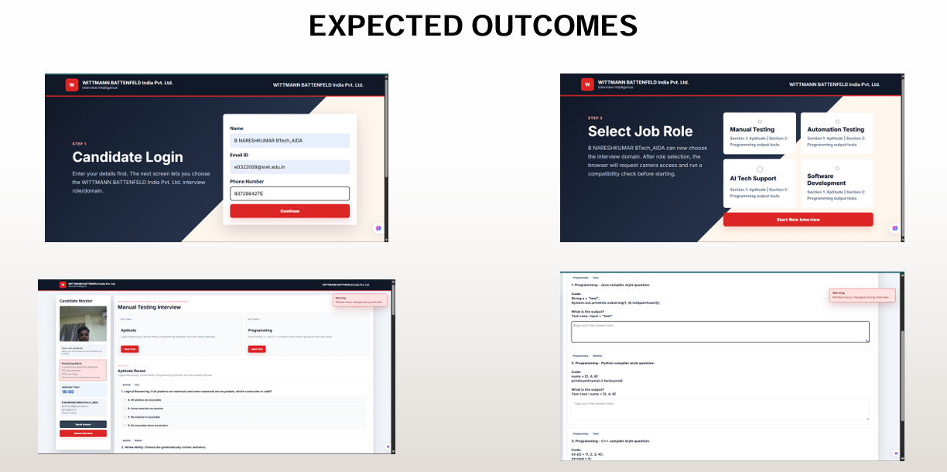

Slide 14
REFERENCES
I. Naim et al., "Automated Prediction and Analysis of Job Interview Performance", 2015.
L. Nguyen and D. Gatica-Perez, "Hirability in the Wild: Analysis of Online Video Resumes", 2016.
L. Chen et al., "Automated Video Interview Judgment on Large Corpus", 2017.
F. Pedregosa et al., "Scikit-learn: Machine Learning in Python", 2011.
K. Sparck Jones, "A Statistical Interpretation of Term Specificity", 1972.
G. Bradski, "The OpenCV Library", 2000.
J. Devlin et al., "BERT: Pre-training of Deep Bidirectional Transformers", 2019.
H. Suen et al., "Artificial Intelligence in Personnel Selection", 2019.

Slide 15
THANK YOU
AI-Based Smart Interview System | Second Review

